Slide 1
Unit 11 For Live Session Assignment
Isabella Westlauer
3/14/2026

Slide 2
SES Model for AUS Air

Slide 3
Activity One: SES (1 hour)
install.packages("fpp")
library(fpp)
# 1. SES MODEL FOR AUS AIR
data(ausair)
#returns a ts object
air = window(ausair, start = 1990, end = 2004)
# Always plot the data first!
plot(air,ylab = "Airline Passegners", xlab = "Year", main = "Airline Passengers")
#fit 3 different simple exponential smoothing models ... how are they different?
# what does the h paramter do?
fit1 = ses(air, initial = "simple",alpha = .2,h = 3)
fit2 = ses(air,initial = "simple",alpha = .6, h = 3)
fit3 = ses(air, h = 3) #defaults
# the forecast package has a nice accuracy funciton with various metrics just pass it the
# the model and the data! (This is the "training" data)
accuracy(fit1, ausair)
accuracy(fit2, ausair)
accuracy(fit3, ausair)
#Reset the plot
plot(air,ylab = "Airline Passegners", xlab = "Year", type = "o", xlim = c(1990, 2008),ylim = c(15,50), main = "Airline Passengers")
#Plot the estimated values from the models .. the "fitted" values are the training values.
lines(fitted(fit1), col = "blue", type = "o")
lines(fitted(fit2), col = "red", type = "o")
lines(fitted(fit3), col = "green", type = "o")
# the $mean values are the forecasts.
lines(fit1$mean, col = "blue", type = "o")
lines(fit2$mean, col = "red", type = "o")
lines(fit3$mean, col = "green", type = "o")
# These are the actual values! Compare visually with the forecasts!
air2008 = window(ausair, start = 1990, end = 2007)
points(air2008, type = "o")
# Compare the forecasts with the actual values with various fit metrics.
accuracy(fit1, air2008)
accuracy(fit2, air2008)
accuracy(fit3, air2008)
Run this code and get a feel for what it is doing. Feel free to change it up and just learn by playing. Create a slide that allows you to discuss the output / analysis / result.
ME RMSE MAE MPE MAPE MASE ACF1 Theil's U
Training set 5.864549 6.301705 5.864549 18.74164 18.74164 3.199632 0.405609699 NA
Test set 11.632265 11.751057 11.632265 24.77018 24.77018 6.346433 -0.003569265 6.140567
ME RMSE MAE MPE MAPE MASE ACF1 Theil's U
Training set 2.576335 3.101549 2.582686 8.507273 8.528313 1.409084 0.206215181 NA
Test set 6.038897 6.264665 6.038897 12.797965 12.797965 3.294755 -0.003569265 3.443693

Slide 4
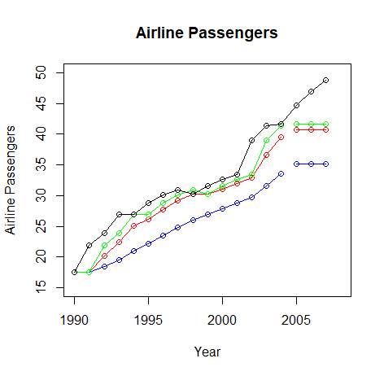
Simple Exponential Smoothing (SES): The data from all of the previous times is not weighted equally- it’s weighted more and more heavily the more recent the time is.
Comparing the accuracy of the three SES fits, the one with default parameters has the lowest error metrics
Fit | Initial | Alpha | h |  | ME | RMSE | MAE
1 - blue | simple | 0.2 | 3 | Training | 5.864549 | 6.301705 | 5.864549
 |  |  |  | Test | 11.632265 | 11.751057 | 11.632265
2-red | simple | 0.6 | 3 | Training | 2.576335 | 3.101549 | 2.582686
 |  |  |  | Test | 6.038897 | 6.264665 | 6.038897
3-grn | defaults | defaults | 3 | Training | 1.602998 | 2.290962 | 1.710834
 |  |  |  | Test | 5.182781 | 5.444168 | 5.182781
ses(
y,
h = 10,
level = c(80, 95),
fan = FALSE,
initial = c("optimal", "simple"),
alpha = NULL,
lambda = NULL,
biasadj = FALSE,
x = y,
...
)
Time periods to forecast
I tried setting alpha = 0 but the errors went up! ses(air, initial = "simple",alpha = 0,h = 3) ses(air) and ses(air, initial = "optimal"), have the same results in accuracy.
Initial parameter doesn’t seem to have any impact on the accuracy output.
Even though fit 3 had the lowest error metrics, it still seems far off from the actual values, (because it fit a linear trend)?
Alpha 0.6 is closer fit than alpha 0.2 but not as good as the default.

Slide 5
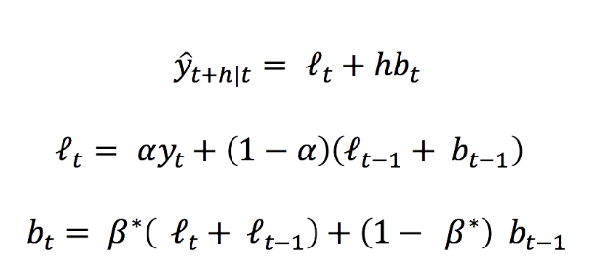
Holt’s Linear Trend Model
Holt’s linear trend method allows for forecasting data with a trend

Slide 6
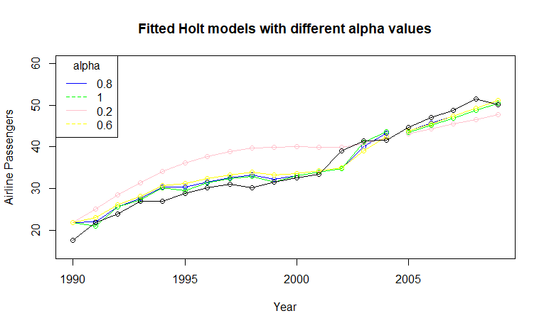
Holt Linear: What does alpha do?
Alpha is the level smoothing parameter, controlling how quickly the level adjusts to new data
Keeping beta = 0.2, alpha must stay between 0-1
Alpha at 0.2 is not as well fit, but 0.6,0.8,and 1 are not very different

Slide 7
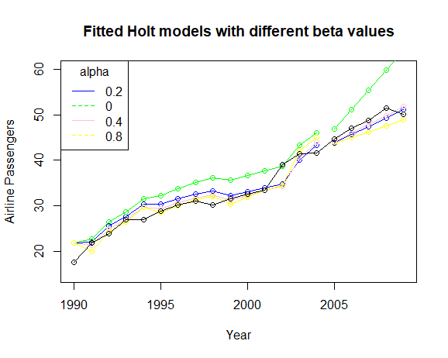
Holt Linear: What does beta do?
Beta is the trend smoothing parameter, controls how quickly the trend estimate adjusts over time
Keeping alpha =0.8, beta must be between 0-1
Beta=0 has the worst predictions, but 0.2, 0.4,0.8 look similar

Slide 8
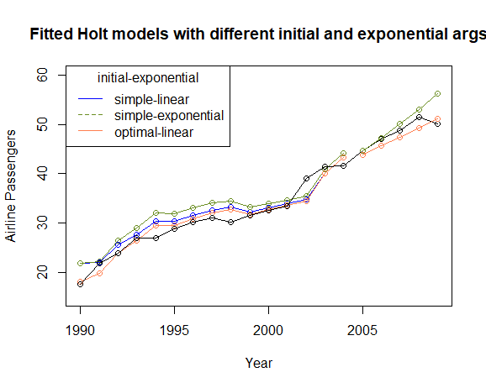
Holt Linear: What does the other args do?
Keeping alpha =0.8, beta =0.2, changing args initial and exponential
Simple-linear and optimal-linear have overlapping forecast
Optimal-exponential is not possible

Slide 9
Holt Seasonal Trend

Slide 10
Activity Three: Holt Seasonal (1 hour)
#3. Seasonal Trend
#Load the data
data("austourists")
# Read about the dataset!
?austourists
# Always plot the data first!
plot(austourists)
# returns a ts object.
aust = window(austourists,start = 1999, end = 2004)
#fit an additive and multiplicative model
fit1s = hw(aust,seasonal = "additive",h = 40)
fit2s = hw(aust,seasonal = "multiplicative",h = 40)
#Plot the original data
plot(aust,ylab = "Australian Tourists", xlab = "Year", type = "o", xlim = c(1999, 2014),ylim = c(15,60))
#add the fitted values from the model (of the training data)
lines(fitted(fit1s),col = "blue", type= "o")
lines(fitted(fit2s), col = "red", type= "o")
#Now add the forecasts (add these one at a time)
lines(fit1s$mean, col = "blue", type= "o")
lines(fit2s$mean,col = "red", type= "o")
#Compare the accuracy
accuracy(fit1s,austourists)
accuracy(fit2s,austourists)
#add the actual values to visually compare the forecasts to the actual values.
points(austourists, type = "o")
We are changing the data this time. Still just learn by playing with the code and looking closely at the input arguments and the output. Create a slide that allows you to discuss the output / analysis / result. Also, record any questions that pop up while you are playing. We can discuss them in live session.

Slide 11
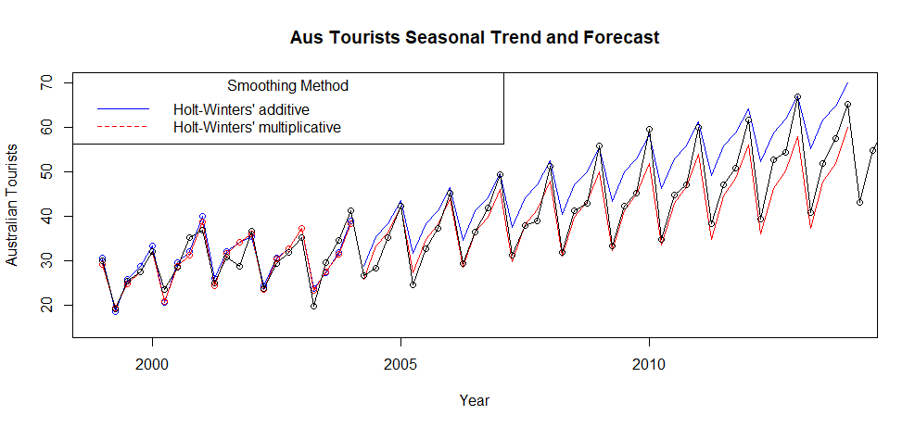
Holt Seasonal: additive method vs multiplicative
The additive forecast looks better fit at the peaks, and the multiplicative method looks better fit at the troughs. Is there a compromise or a tradeoff?

Slide 12
Full Analysis

Slide 13
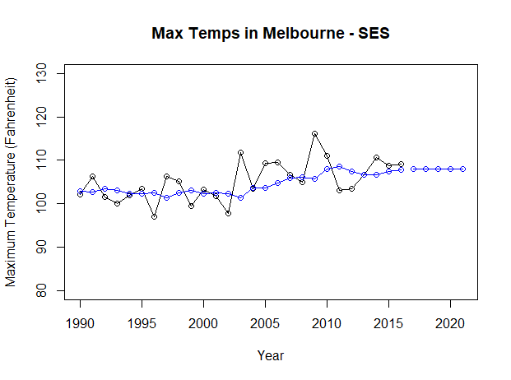
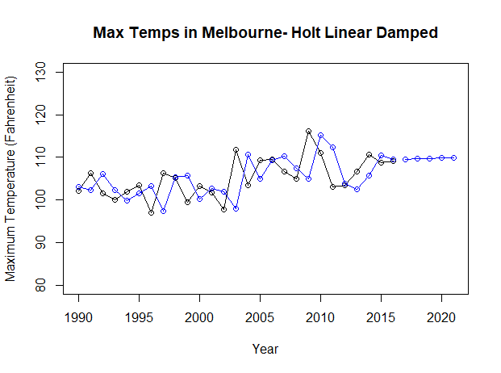
Activity Four: Full Analysis(3-5 hours)
 | SES | Holt
AICC | 173.2707 | 189.7198
BIC | 176.1148 | 193.0849
RMSE | 4.18022 | 5.384864
Aikaike Information Criterion – corrected: SES is lower, fits better Bayesian Information Criterion: SES is lower, fits better Since the SES fit has a lower RMSE, it provides a better fit to the data.

Slide 14
Bonus Problem

Slide 15
Bonus: The Wands Chooses the Wizard
Fun with a great plotting function / package… Dygraphs!
Utilize the dygraphs library. Read in both Unit12TimeSeries_Ollivander and _Gregorovitch.csv as two different data frames. They do not have headers, so make sure you account for that. This is a time series of Wands sold over years.
You don’t have your information in the proper format! In both data sets, you’ll need to first convert the date-like variable to an actual Date class.
Use the library xts (and the xts() function in it) to make each data frame an xts object (effectively, a time series). You’ll want to order.by the Date variable.
Bind the two xts objects together and create a dygraph from it. Utilize the help() index if you’re stuck.
Give an effective title and x/y axes.
Label each Series (via dySeries) to be the appropriate wand-maker. So, one line should create a label for Ollivander and the other for Gregorovitch.
Stack this graph and modify the two lines to be different colors (and not the default ones!) Any colors are fine, but make sure they’re visible and that Ollivander is a different color than Gregorovitch.
Activate a range selector and make it big enough to view.
Use dyShading to illuminate approximately when Voldemort was revived and at-large: between 1995 to 1999.
Enable Highlighting on the graph, so mousing over a line bolds it.

Slide 16
Takeaways and Questions
What are some other models that could potentially produce more accurate forecasts?
How sensitive are the results to the smoothing parameters? Is there an automated way to perform parameter tuning?
How do I know how far into the future I can do my forecasting?

Slide 17
FLS notes
What is random forest
What is the idea of a residual
Why is the aic and bic such a large number
Why do we have MAE, MSPE, etc ways of measuring accuracy and errors
ME tells the bias, if it’s positive or negative your residuals are mostly too high or mostly too low (that’s why you want ME instead of just MAE or RMSE)
Squared residuals gives a bigger penalty for larger errors
Different measures of error can give you a holistic view of the accuracy of your model
Comparing error metrics gives you a good comparison of the characteristics or major problems with your models, ME, RMSE, MAE, MPE, MAPE,
ACF is autocorrelation function
Increase alpha to .95, so yesterday’s weight is 95% important! (then… basically whatever yesterday was is my prediction for today)
If residuals are positive, it’s on average underestimating
Overfitting is?

